Slide 1
Projeto Observability
Iago Freitas – Rodrigo Brito –Thiago Kinjo
Grupo 5

Slide 2

Objetivo
Direcionar nossos esforços de forma mais estratégica e obter os melhores resultados em nossas campanhas de marketing, utilizando os dados relevantes dos últimos 30 dia no nosso e-commerce

Slide 3
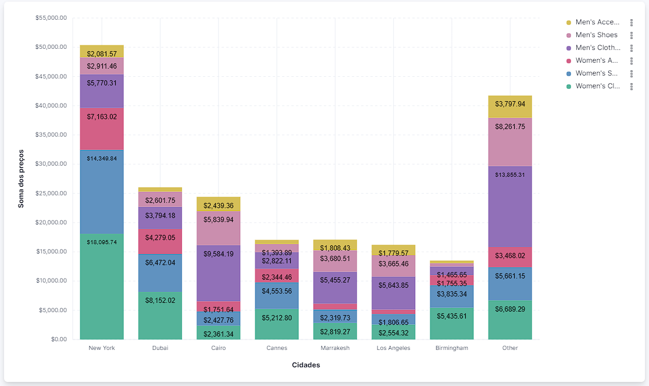
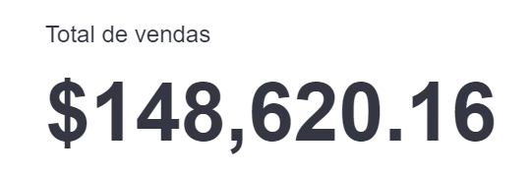
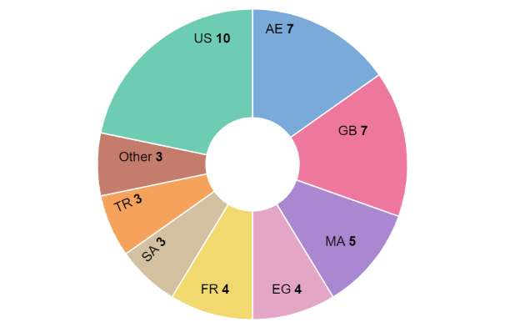
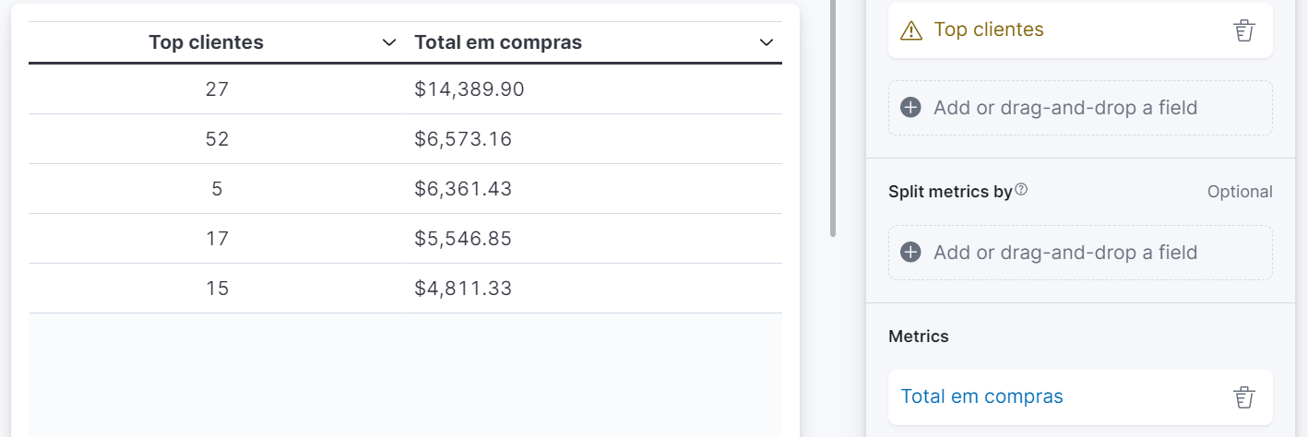
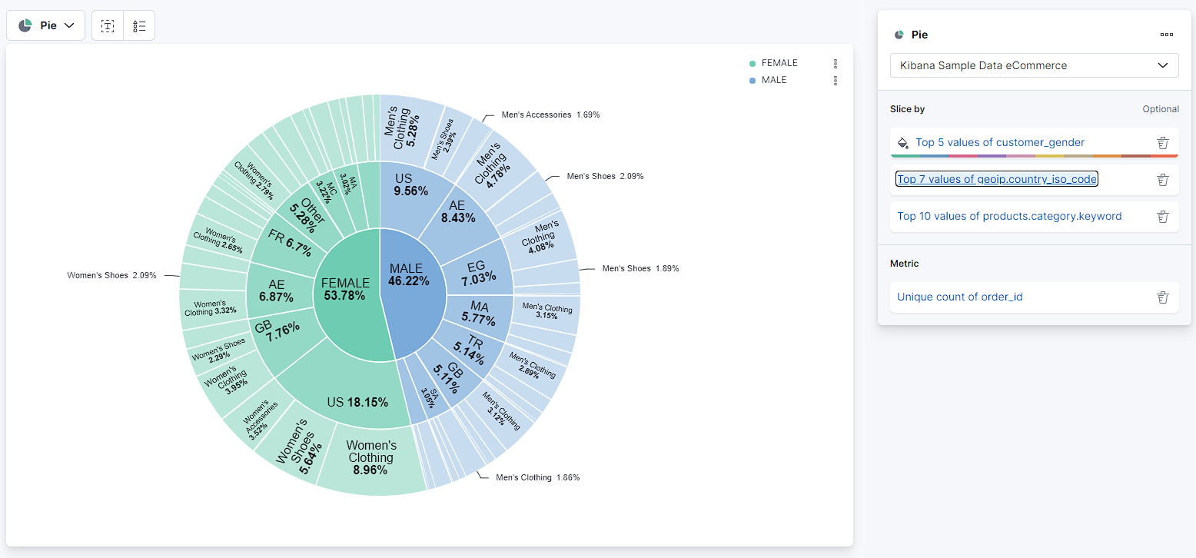
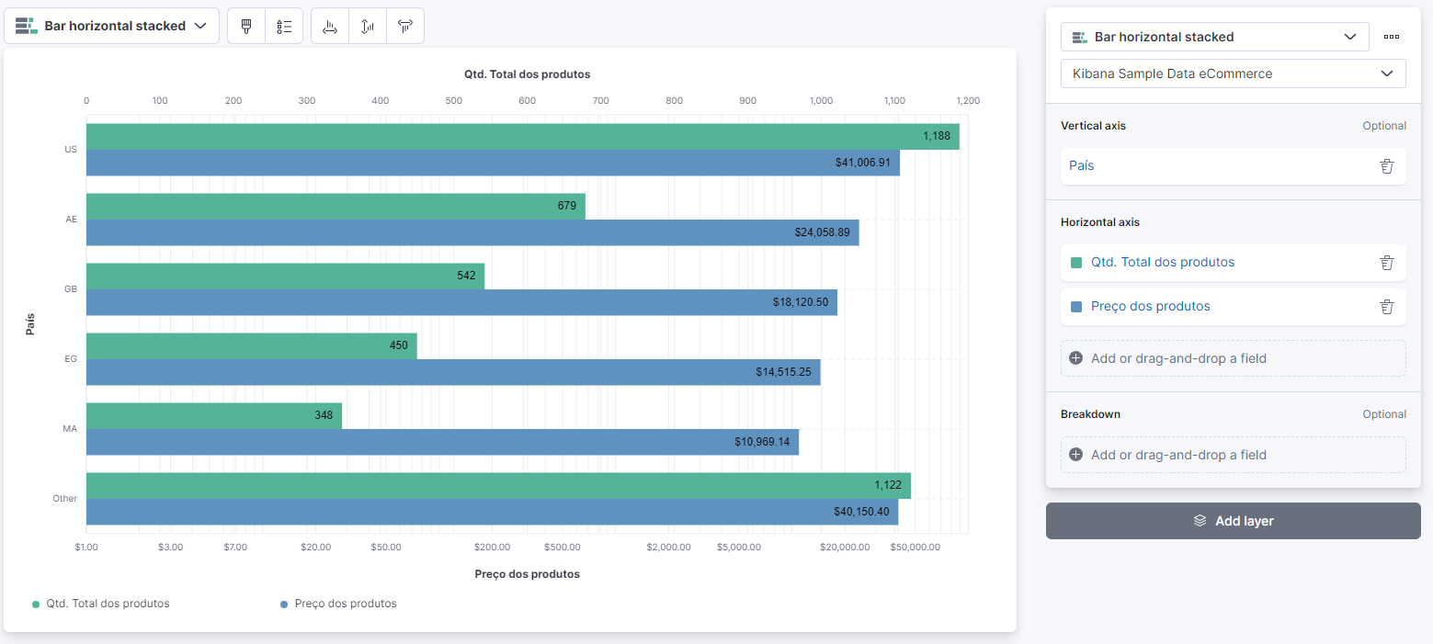
Dashboard

Slide 4
Total de vendas

Slide 5
Vendas por cidades separadas por categorias

Slide 6
Quantidade de produtos vs. Preço por país

Slide 7
Porcentagem de vendas por gênero, país e categoria

Slide 8
Clientes por país

Slide 9
Top clientes

Slide 10
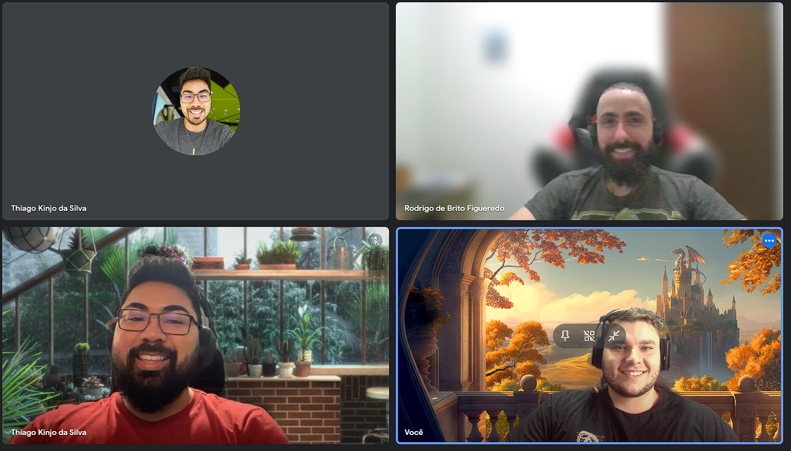
Obrigado!
Grupo 5
Iago Freitas
Rodrigo Brito
Thiago Kinjo
Instrutores:
Livia Branco
Diogo Ferreira

Slide 11
Vendas por cidades separadas por categorias
https://demo.elastic.co/app/discover#/?_g=(time:(from:now-30d%2Fd,to:now))&_a=(columns:!(geoip.city_name,products.category.keyword,products.price),filters:!(),index:ff959d40-b880-11e8-a6d9-e546fe2bba5f,interval:auto,query:(language:kuery,query:''),sort:!(!(order_date,desc)))

Slide 12
Quantidade de produtos vs. Preço por país

Slide 13
Porcentagem de vendas por gênero, país e categoria
https://demo.elastic.co/app/discover#/?_g=(time:(from:now-30d%2Fd,to:now))&_a=(columns:!(customer_gender,geoip.country_iso_code,products.category.keyword,order_id),filters:!(),index:ff959d40-b880-11e8-a6d9-e546fe2bba5f,interval:auto,query:(language:kuery,query:''),sort:!(!(order_date,desc)))

Slide 14
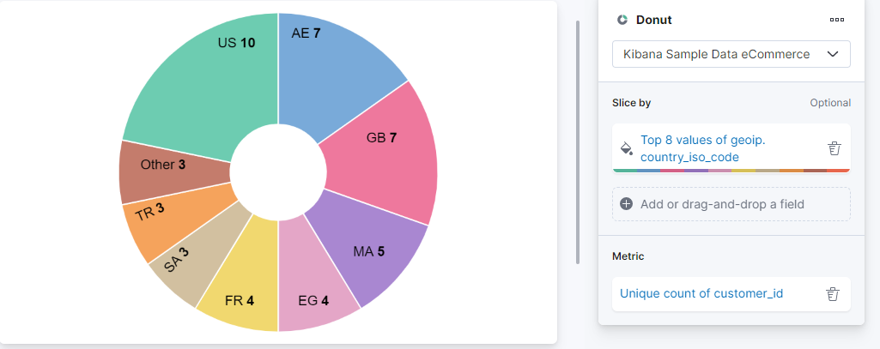
Clientes por país
https://demo.elastic.co/app/discover#/?_g=(time:(from:now-30d%2Fd,to:now))&_a=(columns:!(geoip.country_iso_code,customer_id),filters:!(),index:ff959d40-b880-11e8-a6d9-e546fe2bba5f,interval:auto,query:(language:kuery,query:''),sort:!(!(order_date,desc)))

Slide 15
Top clientes

Slide 16
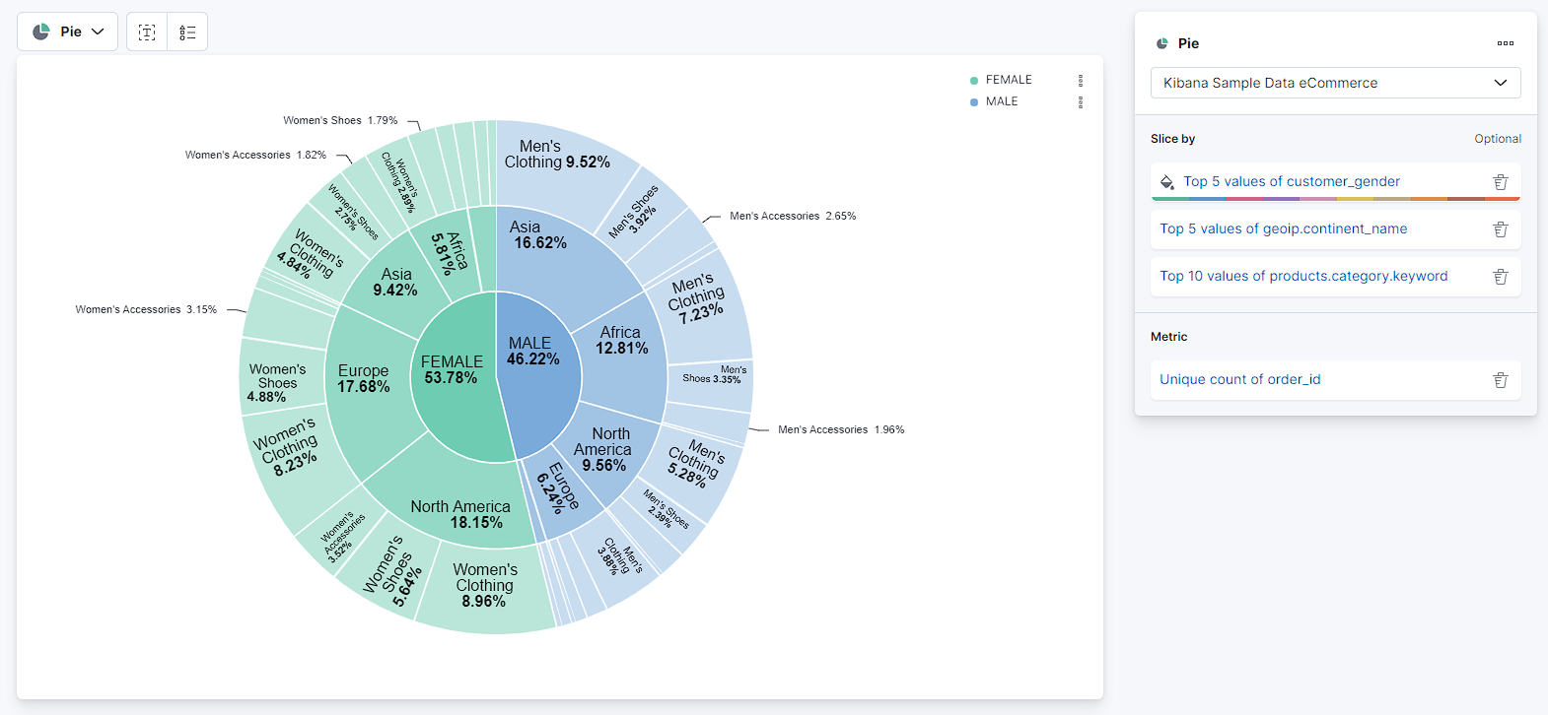
https://demo.elastic.co/app/discover#/?_g=(time:(from:now-30d%2Fd,to:now))&_a=(columns:!(customer_gender,geoip.continent_name,products.category.keyword,order_id),filters:!(),index:ff959d40-b880-11e8-a6d9-e546fe2bba5f,interval:auto,query:(language:kuery,query:''),sort:!(!(order_date,desc)))

Slide 17
https://demo.elastic.co/app/discover#/?_g=(time:(from:now-30d%2Fd,to:now))&_a=(columns:!(customer_gender,geoip.continent_name,products.category.keyword,order_id),filters:!(),index:ff959d40-b880-11e8-a6d9-e546fe2bba5f,interval:auto,query:(language:kuery,query:''),sort:!(!(order_date,desc)))

Slide 18
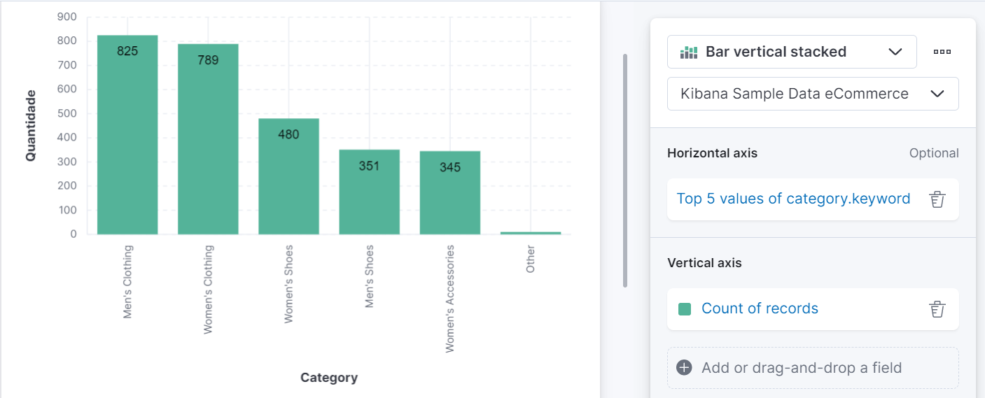
https://demo.elastic.co/app/discover#/?_g=(time:(from:now-30d%2Fd,to:now))&_a=(columns:!(category.keyword),filters:!(),index:ff959d40-b880-11e8-a6d9-e546fe2bba5f,interval:auto,query:(language:kuery,query:''),sort:!(!(order_date,desc)))

Slide 19
Vendas por categoria
https://demo.elastic.co/app/discover#/?_g=(time:(from:now-30d%2Fd,to:now))&_a=(columns:!(category.keyword),filters:!(),index:ff959d40-b880-11e8-a6d9-e546fe2bba5f,interval:auto,query:(language:kuery,query:''),sort:!(!(order_date,desc)))

Slide 20
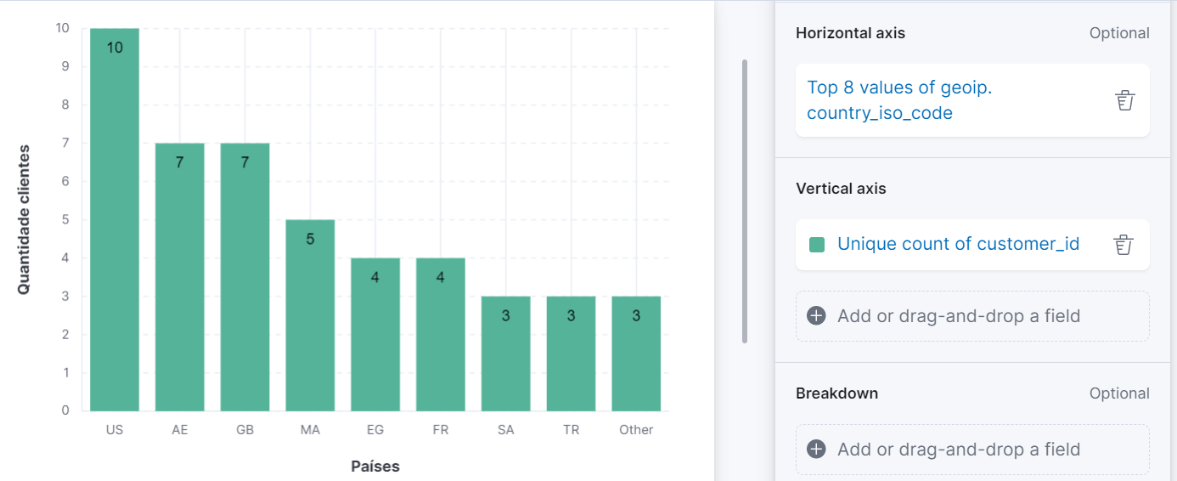
https://demo.elastic.co/app/discover#/?_g=(time:(from:now-30d%2Fd,to:now))&_a=(columns:!(geoip.country_iso_code,customer_id),filters:!(),index:ff959d40-b880-11e8-a6d9-e546fe2bba5f,interval:auto,query:(language:kuery,query:''),sort:!(!(order_date,desc)))

Slide 21
https://demo.elastic.co/app/discover#/?_g=(time:(from:now-30d%2Fd,to:now))&_a=(columns:!(geoip.country_iso_code,customer_id),filters:!(),index:ff959d40-b880-11e8-a6d9-e546fe2bba5f,interval:auto,query:(language:kuery,query:''),sort:!(!(order_date,desc)))

Slide 22
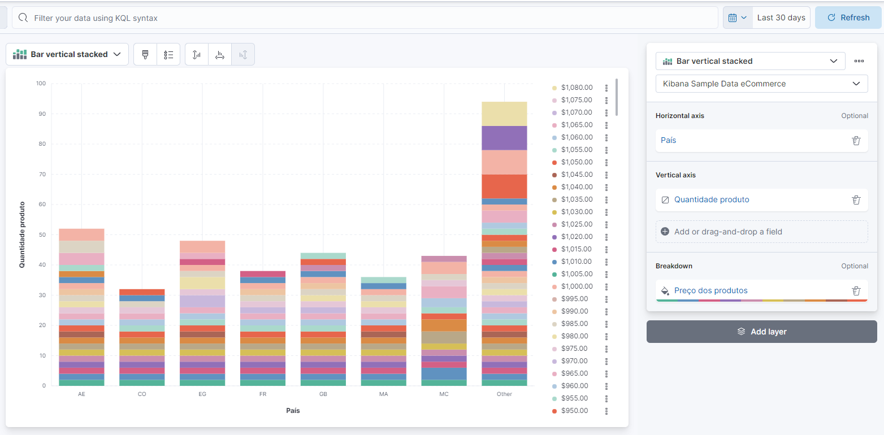
Quantidade de vendas por pais separados por valor

Slide 23
https://demo.elastic.co/app/r?l=DISCOVER_APP_LOCATOR&v=8.7.1&lz=N4IgJghgLhBqCWBTA7gZQA6IMYgFynjDxADMSBOAVnLABYAGAWgCMAOVpgRk8VcYgBsYco0SVaAkogBMzZhEokQAGhAA3RACcAzvAD2AO2IB1AF4BRaQFkAIgE16AOQu0AMjcdFVUeFAA2iMQA1vDyBhAA%2BtoQALboARGQMBHYejExWliB3vAZAGJIfmCOsYG4IHqaYFqJ0Nkg2noArppZBX5QWtp4ANoAut4AnphWiDB4wAC%2BqiSFYHmVMdDd%2BCAwAB4kTX4RUHowO%2Bia8FkTIITEBk0xzFoqIOgQmrEroI9QnZpG5QAk9Mr0AB0PXo9D6IEm0wemj0YCaWCg2kBRxOZQIRHKVxud1Uj2eMVeD2gn2%2BID%2BAMBoIhUI2AW02l2%2Bwgh2Op1WF0x11umnueJeZ3eJOI5KBVMhuJhcIRSNpiHpERRbPRly5OKJ%2BMJgq0pJFlPo1IlsPhiMBGy2LNRZw5ICx3N5T35qy1X2F%2F1F%2BvF0KN0sBMXgBgVrLR5wxNtVPNxDoJAuJ2tdFLFUKO3pN8m0iAiTQMvkDlvZodtar50adsZdvzdeoNXqlqYg6dzSpDKuxEfVjreZZ1lcTUM0WZ8%2BTmVgg6AmUNmiCKAEEPjoBZLjUillcSBAES07qssM0DFA8Jwk4ufYrgzuBwejymkcnaxFwhkzue95fvEydgBHJoQPe%2BQZP3d91wQ8oWZPw9GQRw9AASQMap1jwNc%2FHTVQHzKEAAGlQh%2FCAAAJUFieJEFwmxoDwxAAGE0gyVpAhpXJEAAJR%2FABzYMSBhGJLggxgAGZ6DAAB6Lw1j0bjkAhGZ4A6LpegGEAvy0f9Vj8VjvzY4ImiU%2B5FM0ZSayXZEg1wgA%2BABeXD6Fw6dHBsXDb0M09cIAHgszhQQ9VQdz8a4DBWHoQDYvR4HQQFnygPSIngRoIh3apeWPE1T3uPYDgiL8fx8KB%2Fz6SYgA%3D%3D

